Slide 1


TRASHONLINE
DIGITAL SOLUTION FOR EFFECTIVE WASTE MANAGEMENT

Slide 2




TEAM MEMBERS
Prashant Shah
Navneet Mallick
Pratik Acharya
Prabin Sah

Slide 3
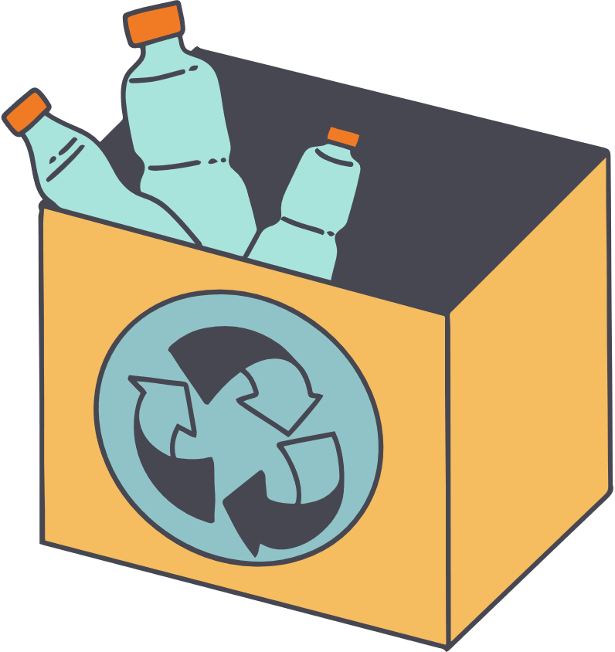
TABLE OF CONTENT
Problem Statement
Approach
Features
Market and Impact
Business Model

Slide 4

Problem Statement
Lack of efficient scrap collection systems.
Difficulty for individuals to recycle due to waiting for collection services.
Environmental impact of non-recycled waste.
.

Slide 5

Approach
Solution
Develop a user-friendly website connecting individuals and businesses to efficient recycling services.
Process
Users schedule pickups or find nearby recycling centers.
Scrap is collected and recycled responsibly through partnered facilities.

Slide 6
Features
For Individual
Easy scheduling for scrap pickups.
Educational resources on recycling best practices
For business
Bulk recycling options.
Dashboard representing waste data
General Features:
Location-based pickup services .
Simple, intuitive user interface for all users.

Slide 7

Market and Impact
Target Market
Individuals: Residents looking for convenient recycling solutions.
Businesses: Companies seeking sustainability initiatives.
Impact Goals:
.
Reduce landfill waste and promote responsible recycling.
Empower communities to adopt sustainable practices.
Drive environmental awareness and education.
Generate Jobs Opportunity

Slide 8

Business Model
Revenue Streams:
Service fees for on-demand scrap collection and pickups.
Subscription plans for businesses managing large-scale recycling operations.
Advertising and sponsorship opportunities with eco-conscious brands.
Collaboration Model
Building a scalable, impactful recycling ecosystem with key partners

Slide 9


Technologies Used

Slide 10
Thank you!

